Slide 1
A Collection-based Digital Product Passport Suitable for Tracking Parts With No ID Presenter: Peter Stein Jonas Brozeit, Abdullah Farrukh, Peter Stein, Christiane Plociennik, Martin Ruskowski 14.11.2025
ISM 2025
International Conference on
Industry of the Future and Smart Manufacturing
Notes:
Good morning, My Name is Peter Stein And i work at the German Research Center for Artificial Intelligence .
Together with System180 and Green-AI Hub we built a digital product passport workflow for modular furniture that does not rely on QR codes or RFID tags.
I’ll show how the Collection Principle, computer vision, and a Neo4j graph give System180 an auditable trace of every reusable component.”

Slide 2
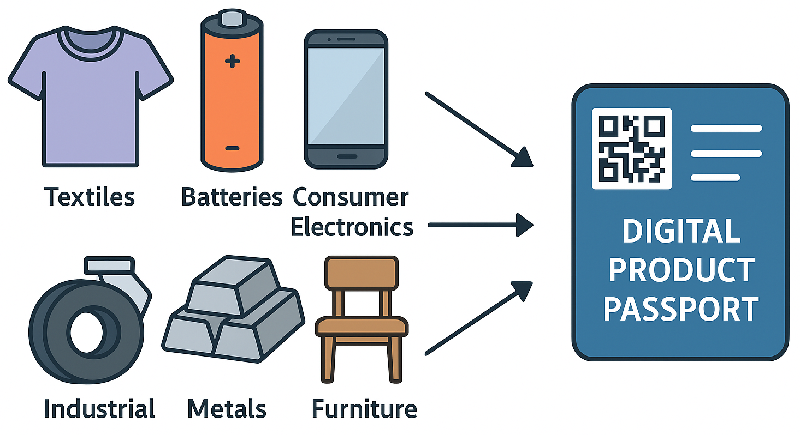
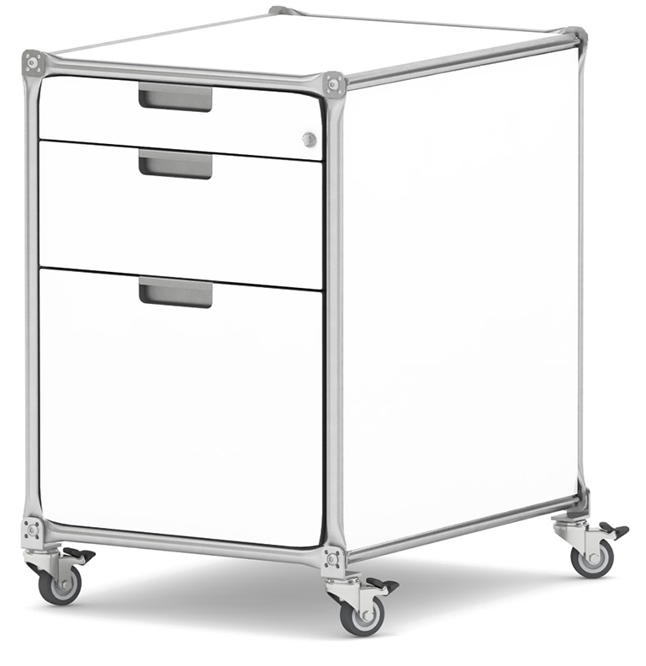
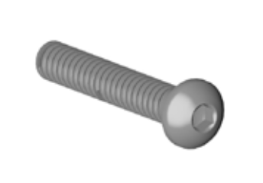
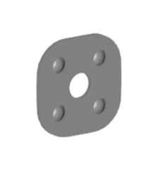
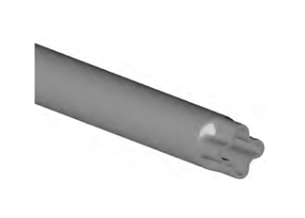
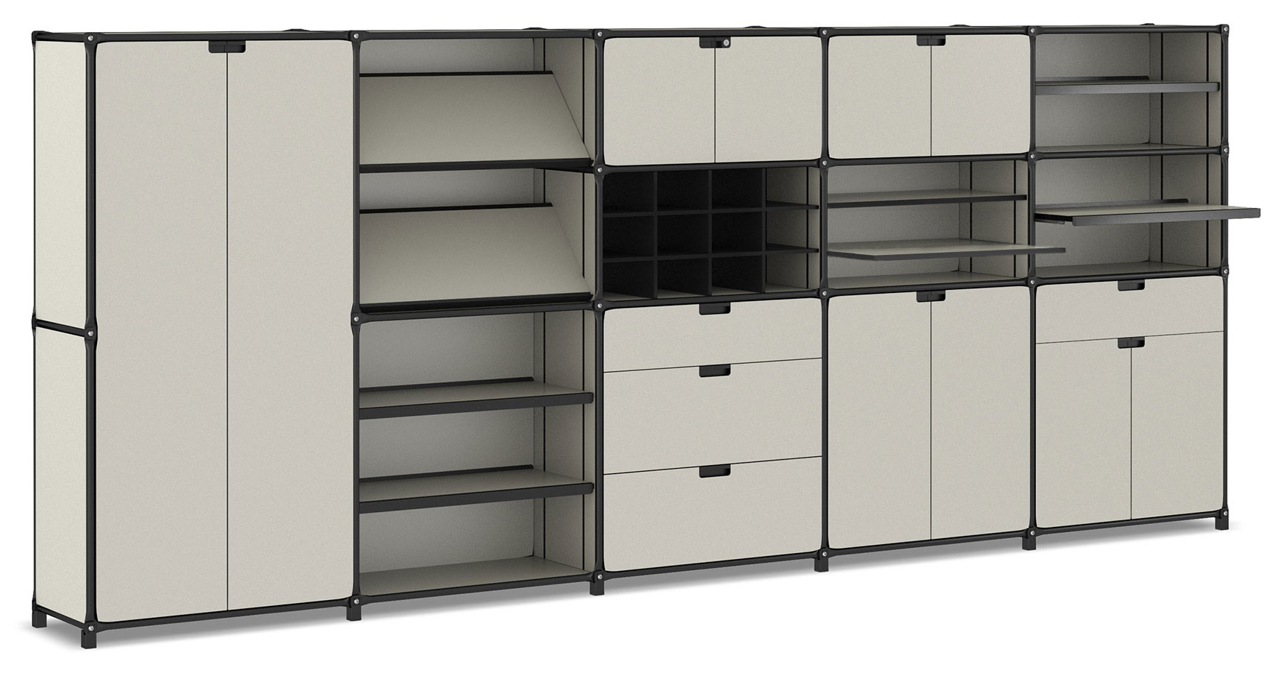
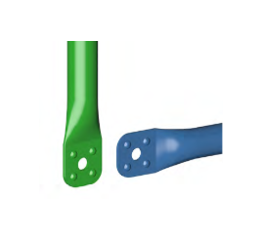
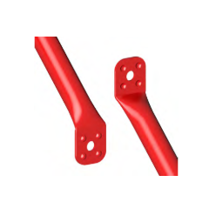
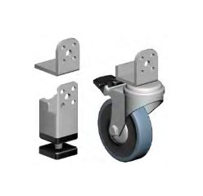

Motivation
Ecodesign for Sustainable Products Regulation (ESPR) will require Digital Product Passports (DPPs) for many product groups like textiles, batteries, consumer electronics and furniture
DPPs will contain information on sustainability performance, repairability, and end-of-life information
European Commission's approach to more environmentally sustainable and circular products.
System180 builds modular furniture through stainless tube systems designed for 20+ years of reuse
Notes:
The Ecodesign for Sustainable Products Regulation mandates DPPs for many sectors, including furniture. A DPP isn’t just a PDF; it needs live data on composition, condition, and circularity. System180 builds stainless tube systems that stay in service for decades, but today’s manual inventories can’t keep pace. Our goal is to automate how those components are documented so reuse becomes faster and compliant
Furniture manufacturers will be required to include Digital Product Passports (DPPs) with their products
DPPs will contain information on sustainability performance, repairability, and end-of-life information
Furniture is explicitly listed in the ESPR Working Plan 2025–2030 adopted by the European Commission in April 2025.
The Ecodesign for Sustainable Products Regulation (ESPR), which entered into force on 18 July 2024, is the European Commission’s approach to more environmentally sustainable and circular products.
The goal is to reduce impact on the environment and reduce polution.
It's a mandatory EU requirement under the ESPR framework

Slide 3
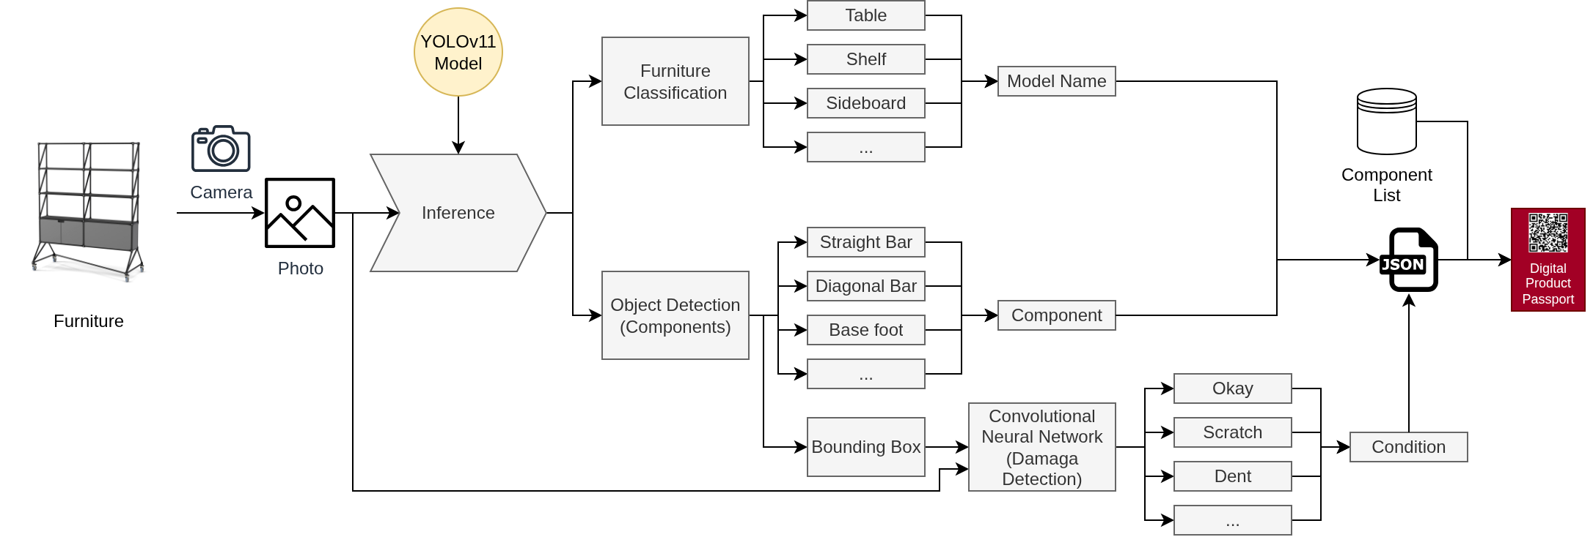
Solution Concept: Collections
YOLOv11 models trained on synthetic data (NVIDIA Isaac Sim) and labeled photos
Notes:
We solve ID-free tracking through Collections. Every component always belongs to exactly one digital collection — a stockpile, an order, a disassembly batch. Moving a part physically just means reassigning it digitally, so we preserve lineage without stickers. We populate collections by running a YOLOv11 ensemble on each photo; the reason the slide mentions Isaac Sim is because synthetic data let us bootstrap detectors for nine component classes with little manual labelling.
Every component always belongs to exactly one digital Collection (order, stockpile, kit).
Moving a physical part = reassigning it between Collections inside Neo4j.
Collections carry location, customer, and lifecycle metadata → no QR code needed on parts.
Neo4j queries enforce the Collection Principle, so nothing “floats” untracked.

Slide 4
Training
YOLOv11 (real photos)
YOLOv11 (synthetic data)
fused via IoU voting
Custom CNN for condition (okay, scratch, dent ).
Color & coating via K-Means palettes
≈10k Isaac-Sim renders + ≈1k labeled factory photos (Label Studio workflow).
Notes:
We train two YOLOv11 variants — one on ~1,000 factory photos to capture real reflections, one on ~10,000 Isaac-Sim renders to cover occlusions. We fuse them via IoU voting so low-data classes aren’t lost. Damage detection uses our ZustandModel CNN, and décor detection uses curated palettes. All of this runs in FastAPI so we can retrain whenever new Label Studio exports arrive.

Slide 5
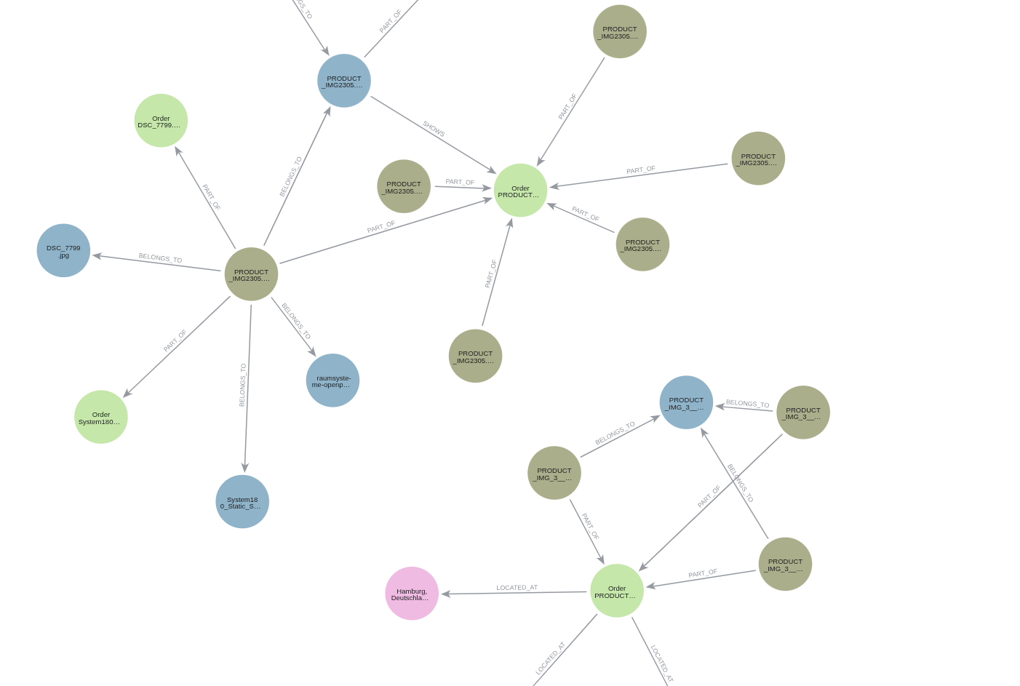

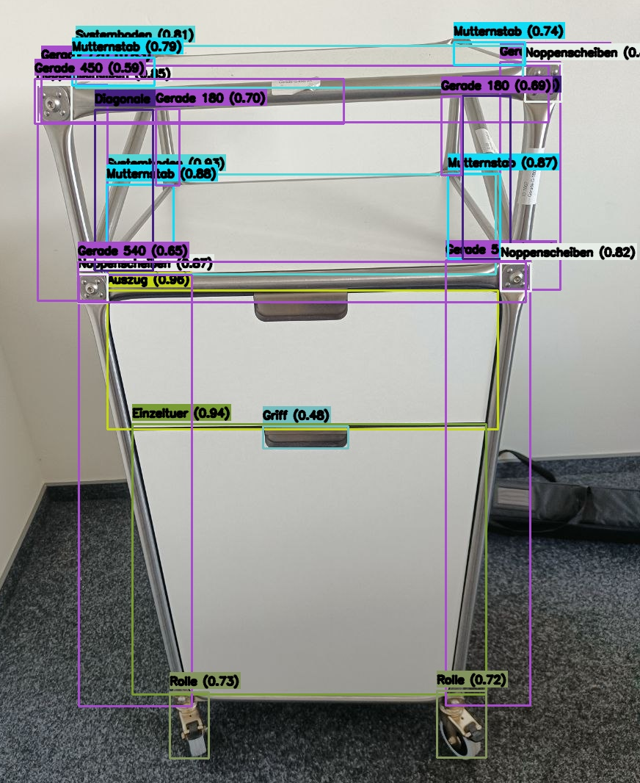
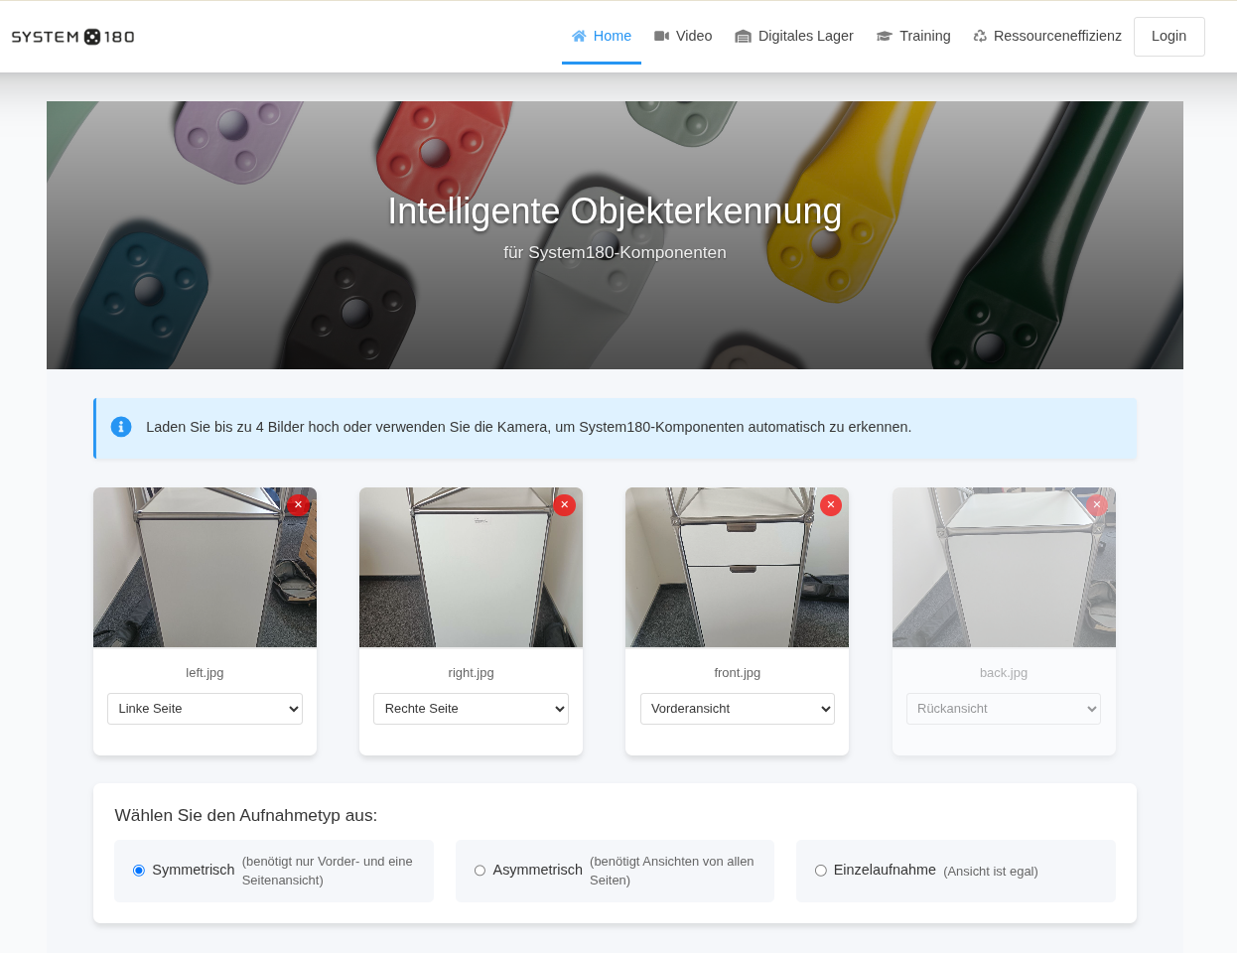


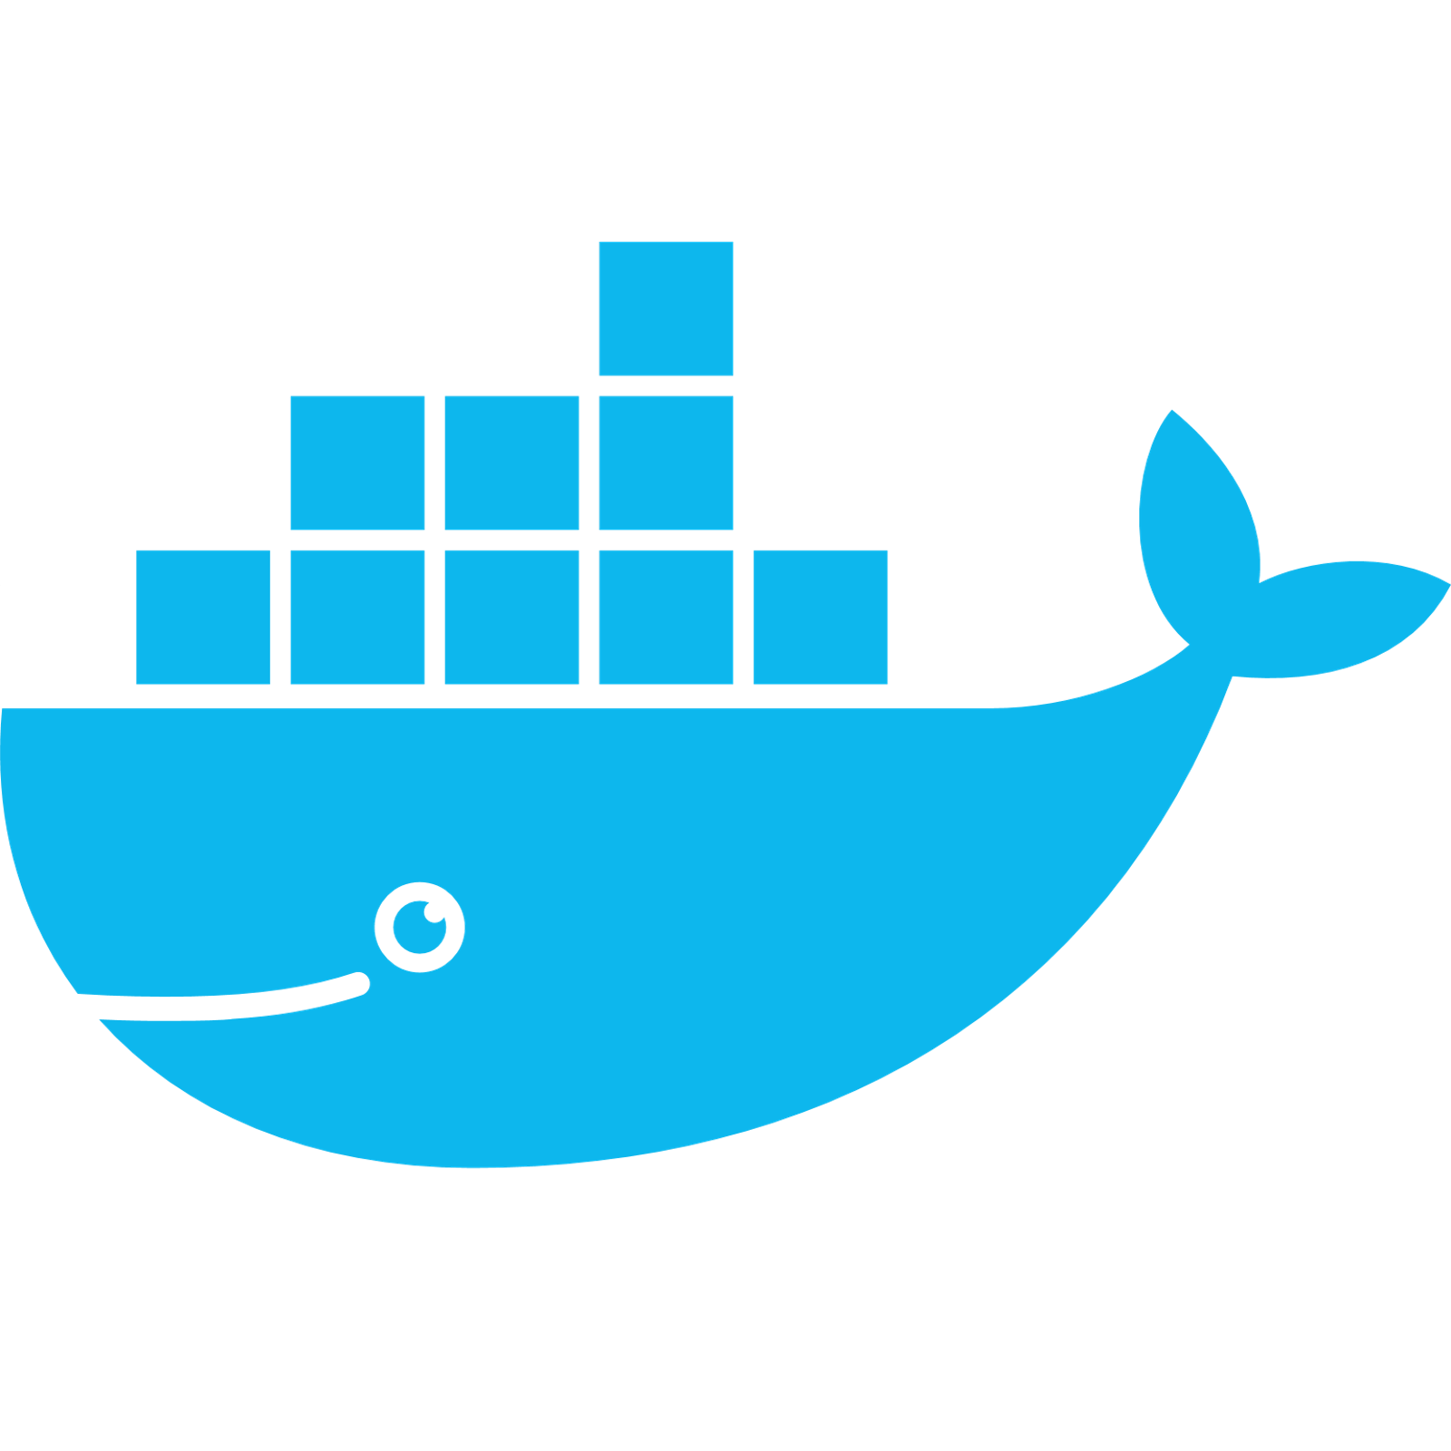



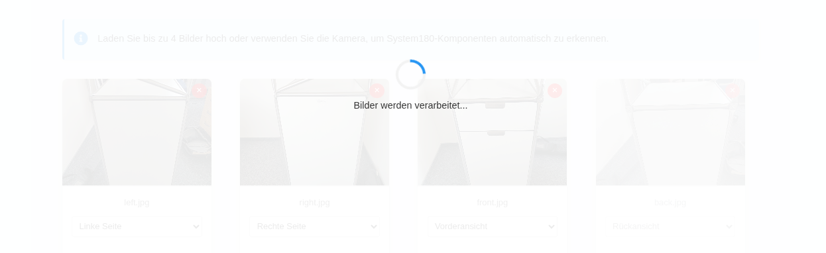
Technical Implementation: Web Application
Web App
Image
DPP
User
Notes:
Operators upload up to four views — front, back, left, right — through a FastAPI app. Each image goes through the ensemble, colour and measurement heuristics, and then a human review screen lets operators delete duplicate detections before committing. When they click Save, we run a single Neo4j transaction to merge the image/order nodes and CREATE fresh component nodes linked via PART_OF and BELONGS_TO. The screenshots in webapp/screenshots/* show this flow.”
Capture images or video (browser upload, webcam, or edge rig).
YOLOv11 ensemble detects components; measurement + décor modules enrich attributes.
Operators review detections, adjust condition labels, and submit.
Neo4j persists Order → Image → Component → Location, powering dashboards + CSV exports.
Everything runs on FastAPI + Docker; no cloud dependency for inference.
- “We capture up to four views (front/back/left/right) per furniture item and run each image through a YOLO ensemble; detections include a view label (ansicht).”
- “Within one view, overlapping boxes from the two YOLO models are merged; across views we currently keep components separate and rely on the operator to delete duplicates before
saving.”
- “In Neo4j every confirmed detection becomes a Component node linked to an Image and an Order. We do not yet fuse multi-view detections into a single ‘physical part’ node –
that’s future work (multi-view fusion / structure reasoning).”
- The Neo4j graph stores four node types: Order (one per collection/order with ID, type, contact, geo), Location (city-level nodes with lat/long), Image (one per file name), and
Component (one node per detected part).
- Each detected component node carries rich properties: class (Gerade, Noppenscheiben, etc.), a comp_id, bounding box (x_min, x_max, y_min, y_max), inferred length (laenge),
weight band (gewicht), model confidence, condition (zustand, e.g. unbeschädigt, MDF-Platzer), reuse flags (reusable/reuseable), and décor/coating as a JSON blob (farbe with
name, HEX, NCS).
- Relationships link everything into collections: Order-LOCATED_AT->Location, Image-PART_OF->Order, Component-PART_OF->Order, and Component-BELONGS_TO->Image (plus some extra
BELONGS_TO links to reference images). So the graph represents both the whole image (as an Image node) and every individual component detected in it, all tied back to a
specific order/collection and location.
FastAPI caches per-image DataFrames for edits before writing to Neo4j.
Operators can override classes, conditions, or lengths; CNNs can be re-triggered on crops.
Works on laptops/tablets; browser only handles HTML forms, keeping deployment simple.
Implementation flow (docs/images/Architektur.png)

Slide 6
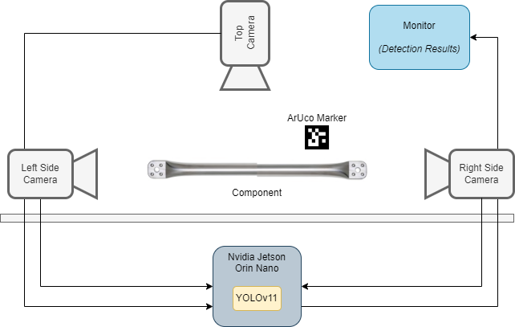
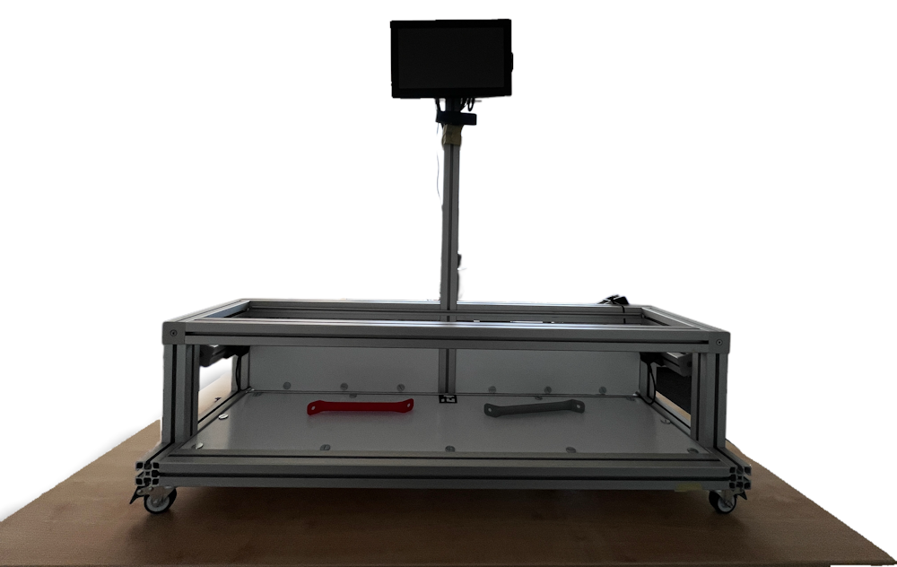
Demonstrator
Camera
Camera
Camera
Notes:
For shop-floor capture we built a mobile rig: two DepthAI OAK-1 Max cameras on the sides run nub segmentation, and a 4K overhead camera feeds YOLO plus ArUco-based measurement. Everything runs on a Jetson Orin Nano in FP16, 30–60 FPS at 320² input. Because the rig runs offline on a trolley, System180 can digitise returns without hauling them to a studio.
Jetson Orin Nano executes FP16 TensorRT YOLO + nub segmentation from two OAK-1 Max.
OBSBOT 4K top camera handles component view + ArUco measurement (edge only).
Operates offline on 230 V trolley; monitor gives immediate feedback.

Slide 7
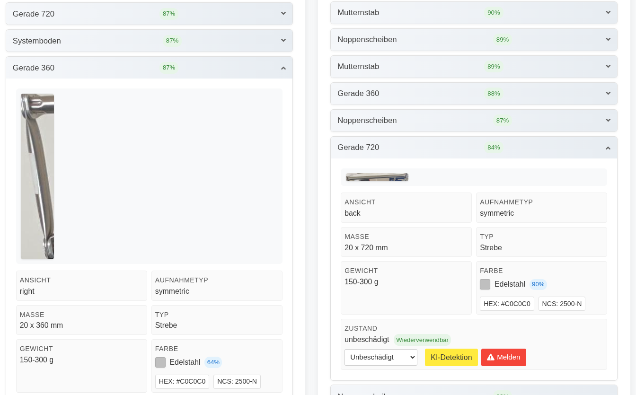
Results
Detection & Measurement
9 component classes reliably detected in browser uploads and edge rig.
Measurement heuristics map pixels to the nearest catalogue length (180–900 mm) using known references.
Condition CNN surfaces scratches/dents before operators decide on reuse.
Notes:
In browser workflows and on the rig we reliably detect nine target classes. The measurement heuristics map to catalogue lengths — 180 to 900 mm — by using known handles or feet as references. The condition CNN flags scratches or dents so the operator knows immediately whether a tube is reusable or goes to refurbishment.

Slide 8
Limitations
Condition Detection:
Scratches and small dents are hard to see in RGB photos.
Condition CNN still need human verification
Multi-view fusion:
Each view is stored separately, no automatic algorithm merges front/back/left/right detections into a single 3D-model yet
Edge performance:
Jetson Orin throttles when four models run simultaneously;
Converted models to TensorRT .engine files and reduced them to FP16 to stay within power/thermal budgets.

Slide 9
Conclusion
Camera-based, ID‑free workflow delivers the core DPP data for modular furniture (class, length band, décor, condition).
Collection Principle in Neo4j ensures every component belongs to exactly one order/collection, giving a continuous trace over reuse cycles.
YOLOv11 ensemble + measurement heuristics + colour and condition pipelines populate these attributes consistently in edge demonstrator.
Populated Neo4j graph, dashboards and CSV exports provide concrete evidence that the approach runs on real System180 data today.

Slide 10
Outlook
Improve defect capture with better optics/datasets so the condition model can reliably see very small scratches and dents.
Develop multi‑view fusion to combine front/back/left/right detections into a single 3D‑consistent component representation in the graph.
Introduce multi‑marker photogrammetry on the rig and more robust length estimation in the web workflow.
Map the Neo4j schema to Asset Administration Shell (AAS) / Ontology Design Pattern vocabularies and add an ESPR‑compliant DPP export service.
Add furniture‑level classification and incremental/on‑device learning so new components and variants can be integrated without full retraining.

Slide 11
Thank you for your Attention
Contact: peter.stein@dfki.de
GitHub: http://github.com/Green-AI-Hub-Mittelstand/SUSPEKT
Time for Questions
Notes:
All code is open under Green-AI Hub. Reach out if you want to validate this on your own modular product lines.

Slide 12
Sources
https://commission.europa.eu/energy-climate-change-environment/standards-tools-and-labels/products-labelling-rules-and-requirements/ecodesign-sustainable-products-regulation_en

Slide 13
Screenshots

Slide 15
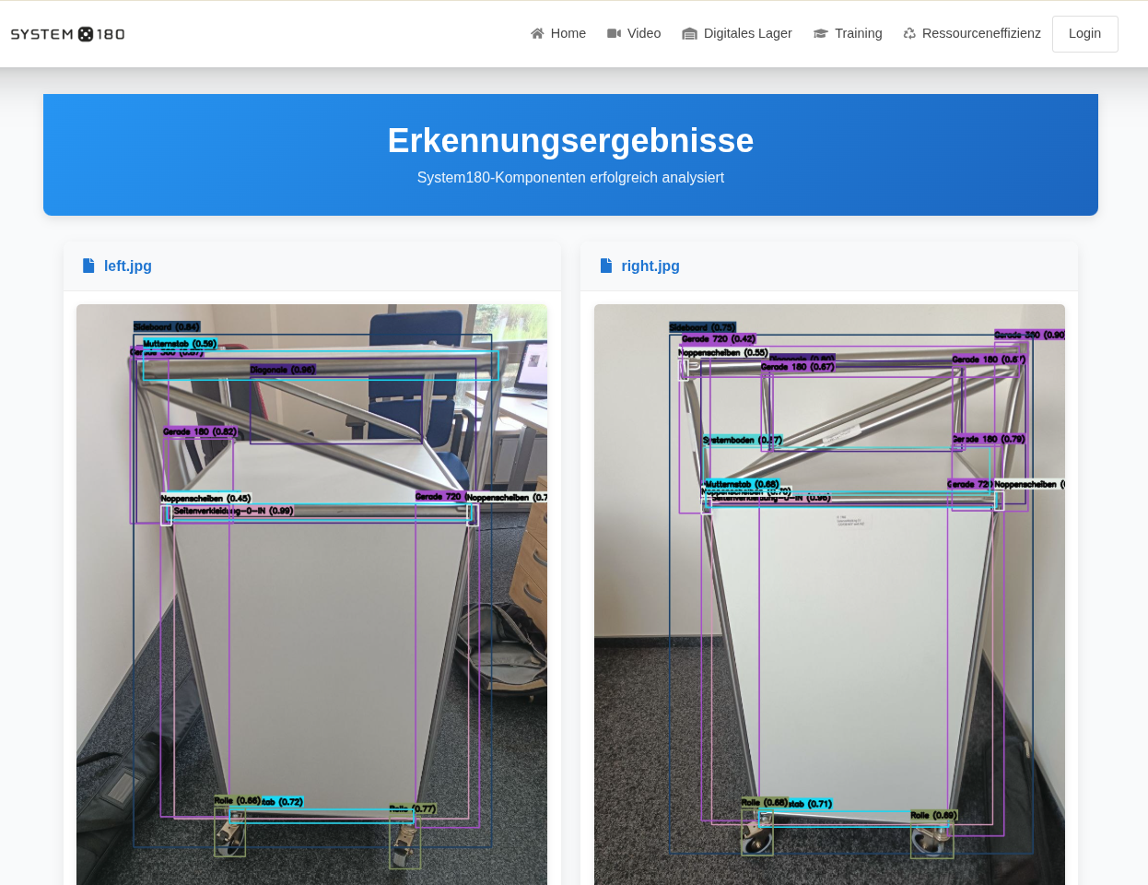

Slide 16
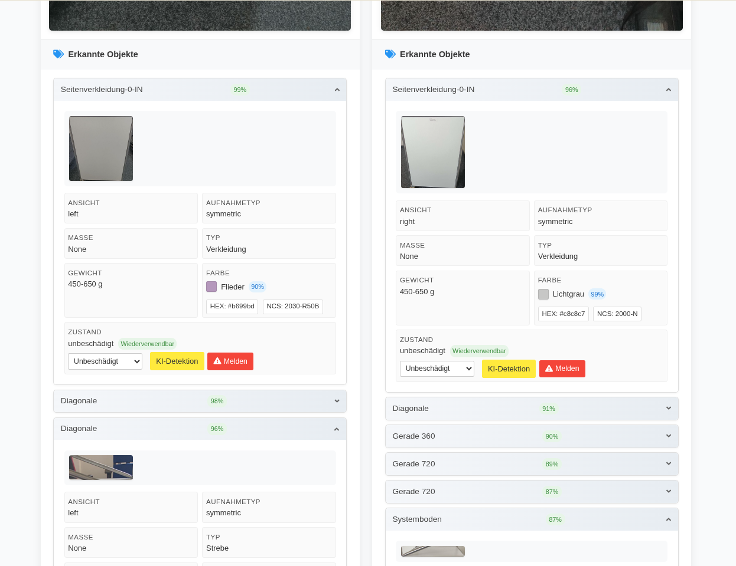

Slide 17
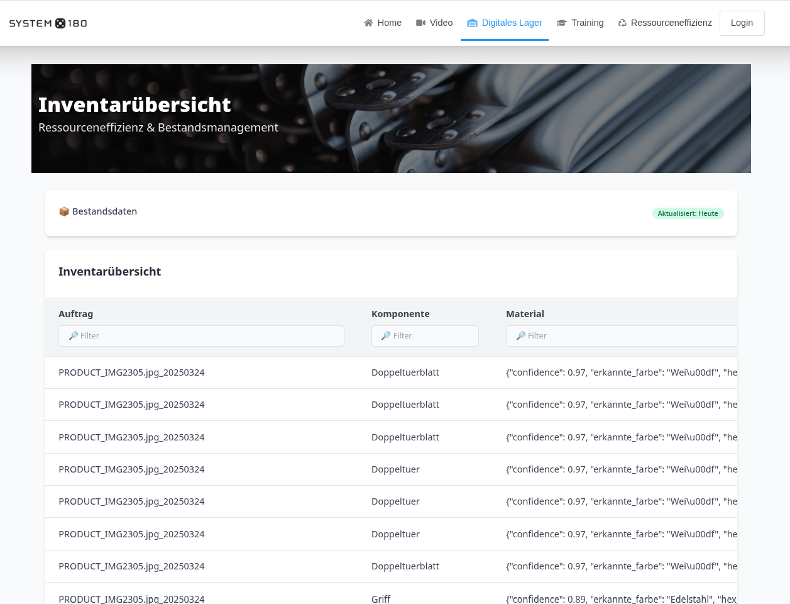

Slide 18
